Slide 1
Backorder prediction
Detailed Project Report
Written By M.Shabarish

Slide 2
Objective
Backorders are unavoidable, but by anticipating which things will be backordered, planning can be streamlined at several levels, preventing unexpected strain on production, logistics, and transportation. Developing a predictive model the model able to predict whether a model is going to be backordered or not
Benefits
Reduces the strain on logistics.
Better inventory management.
Identifying parts with the highest chances of shortage prior its occurrence.

Slide 3
Data Sharing Agreement
Train file name(Kaggle_Training_Dataset_v2) and test file name(Kaggle_Test_Dataset_v2)
Number of columns : 22
Name of the columns : Product id,inventory level, lead time, transit time, product performance features(2), product sales quantity features(4), product sales forecast variables(3) , and 7 risk flag features and a target features.
Data type of the columns : 15 numerical features, 7 Categorical features.

Slide 4
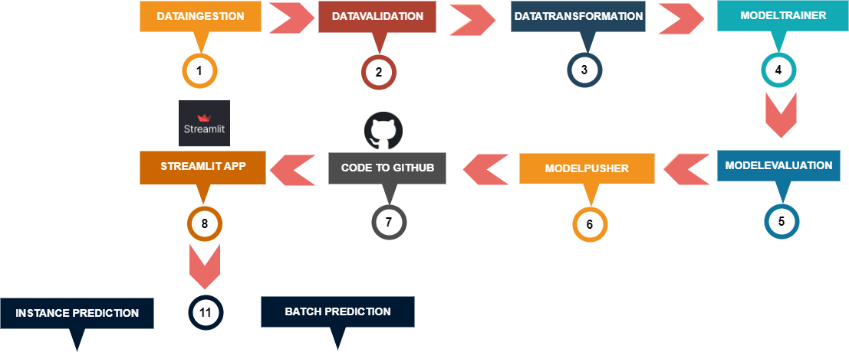
Architecture

Slide 5
Data Ingestion
Data Validation
1. Loading the data from Amazon S3 bucket.
2. Performing the train test split.
3. Saving the dataset and train test splits to Data Ingestion artifacts
.
1. Checks for columns in base and current dataframe.
2. Checks for data drift in base and current dataframe
3. Saving report file the form .yaml in Data validation artifacts

Slide 6
Data Transformation
1. Performs Data transformation operations
2. Performs missing value imputation using simple imputer
3. Scaling the numerical features
4. Encoding the categorical and target features
5. Saving imputer and transformer objects to Data transformation artifacts

Slide 7
Model Training
Random Forest Classifier is used to predict the backorders. It is a popular machine learning algorithm that is used for classification tasks. It is a type of ensemble learning method that combines multiple decision trees to make more accurate and robust predictions.
In a Random Forest Classifier, each decision tree is built on a randomly selected subset of features and training samples, which helps to reduce the risk of overfitting and improve the generalization ability of the model. The final prediction is made by aggregating the predictions of all the decision trees in the forest, using either a majority vote.
The trained model is evaluated using the micro f1-score.
After training the RandomForestClassifier the model is saved in model trainer artifacts folder.

Slide 8
Model Evaluation
Model Pusher
1 . The Current model is evaluated with the previous model. If there is no previous model current model is saved in saved models.
2. If there is a previous model the current model is evaluated with previous. The best model is saved in saved models folder
3. If the previous model is better than current training model. The training process will be stopped and raises an exception.
1 . Saving the latest imputer and transformer objects.
2. Saving the best model into model registry.

Slide 9
Prediction
Instance Prediction : For instance prediction the user enter the required values through streamlit application those values are preproccessed and prediction will be displayed on to the page.
Batch Prediction : For batch prediction the user need to dowload the data from the correct github raw file url that is provided. And upload the dowloaded dataset. The predictions will be displayed on to the page and the user can able to dowload the predictions.

Slide 10
Conclusion
Successfully completed the end-to-end machine learning backorder prediction project which can predict the backorders and reduces the strain on logistics, production and transportation.

